Slide 1
Physical Activity
Mr. Lopez & Mr. Guzzarde

Slide 2
Video Clip
https://www.youtube.com/watch?v=wzhzkKccBi8

Slide 3
Being Fit
Physical Activity – any movement that makes your body use extra energy
Fitness – capability of the body of distributing inhaled oxygen to muscle tissue during increased physical effort
Exercise – is planned physical activity done regularly to build or maintain one’s fitness

Slide 4
Five Elements of Physical Fitness
Muscular Endurance
Using force over a period of time
Cardiovascular Endurance
How well your heart and lungs work during physical activity
Strength
The ability of your muscles to use force
Flexibility
The ability to move joints freely and easily through a full range of motion
Body Composition
The proportion of fat, bone, muscle, and fluid that make up your body weight

Slide 5
Types of Exercise
Aerobic – Rhythmic, moderate to vigorous activity that uses large amounts of oxygen working the heart and lungs
Dance
Running
Biking
Anaerobic – intense and short physical activity that builds muscle
Lifting Weights
Sprinting
Jump Training

Slide 6
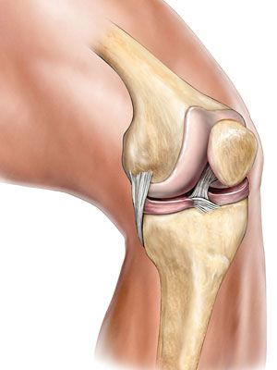
The Skeletal System
The framework of bones and other tissues that support the body
Joints – places where two or more bones meet
Tendons – are a type of connecting tissue that joins muscles to bones AND muscles to muscles
Ligament – type of connecting tissue that holds bones to bones at the joint
Cartilage – a strong flexible tissue that allows joints to move easily, cushions bones, and supports soft tissues

Slide 7
The muscular system
Includes tissues that moves parts of the body and operate internal organs
Smooth – organs (involuntary)
Skeletal – work together to move bones
Cardiac – special type of involuntary muscle
Human body has more than 600 muscles

Slide 8
Circulatory System
The group of organs and tissue that act as transfer stations carrying needed materials to cells and removing their waste products
Arteries – blood vessels that carry blood away from the heart
Veins- blood vessels that carry blood to the heart

Slide 9
The Process of Circulation
Pulmonary Circulation – takes place when blood travels from the heart, through the lungs, and back to the heart
Systemic Circulation – takes place when oxygen rich blood travels to all body tissues except the lungs

Slide 10
F.I.T.T.
Frequency – refers to the number of days you work out each week
Intensity – how much energy you use when you work out
Time – how much time you spend during each workout session
Type – which type of exercise? (aerobic/anaerobic)

Slide 11
Common Injuries
Major Injuries
Dislocation – happens when a bone is forced out of a joint
Fracture – break in the bone
Stress Fracture – small fracture caused by repeated strain
Minor Injuries
Sprain – injury to the ligament connecting bones at a joint (torn or stretched to far)
Tendonitis – painful inflammation of a tendon caused by overuse

Slide 12
Journal Questions
Which quotes meant to most to you in the video and why?
2. What type of physical activities do you enjoy the most? When can you find time to fit these activities in your day? If you are not exercising every day, what is stopping you?
3. Explain your current physical activity schedule using F.I.T.T. How often per week? How intense per session? How long per session? What type of exercise? *Remember physical activity can consist of PE class, recess play, and other hobbies.

